Slide 1
My ideal school
What I would like to see in my school ?
1.what should be the school building??
2.what should be the timetable??
3.what should be the
relationship between
teachers and students??
4.what should be a section at school??

Slide 2
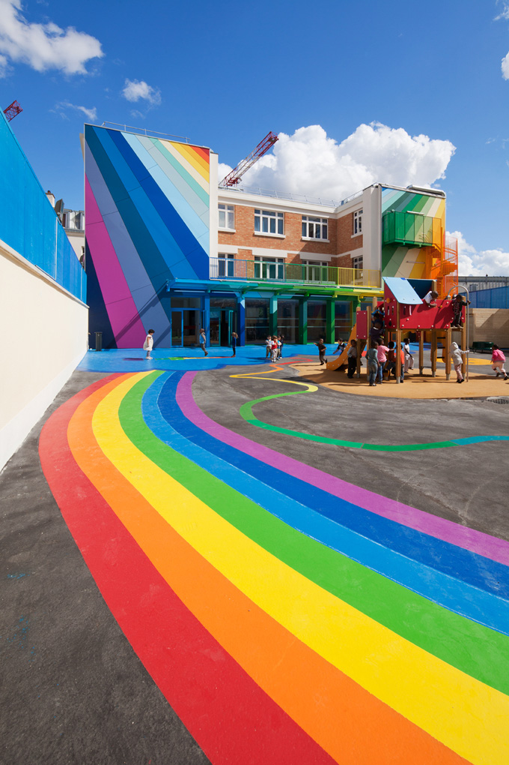
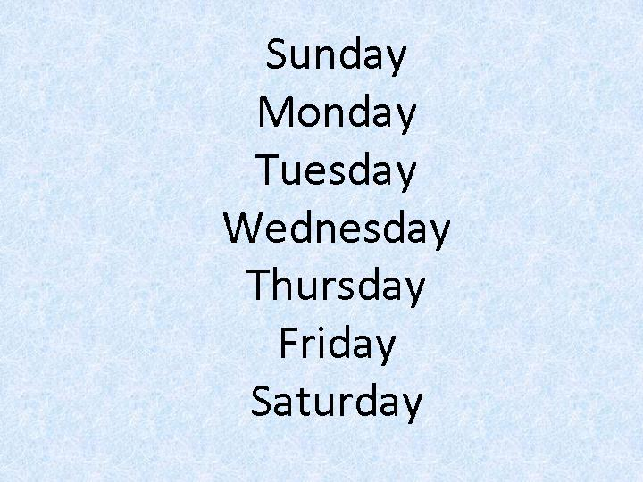
the school building///school timetable
I want the
school building
Would be multi-colored.
That would be a computer
Room,
recreation
area that,
in each
corridor would be benches.
I want to schedule of the lessons would be this :
every day 3 lessons,
Saturday and Sunday weekend. vacation
4 times a year.

Slide 3
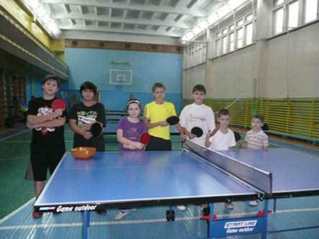
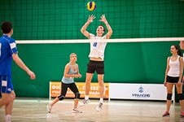
relationships between teachers and students...school section
I want teachers and students to talk, to
understand each other. to
communicate and to be understanding
I want to be at school. there would be a lot of sections.the children would go they.to dance,to choir,
To the theatre and many others.
Let the school be creative

